Slide 1


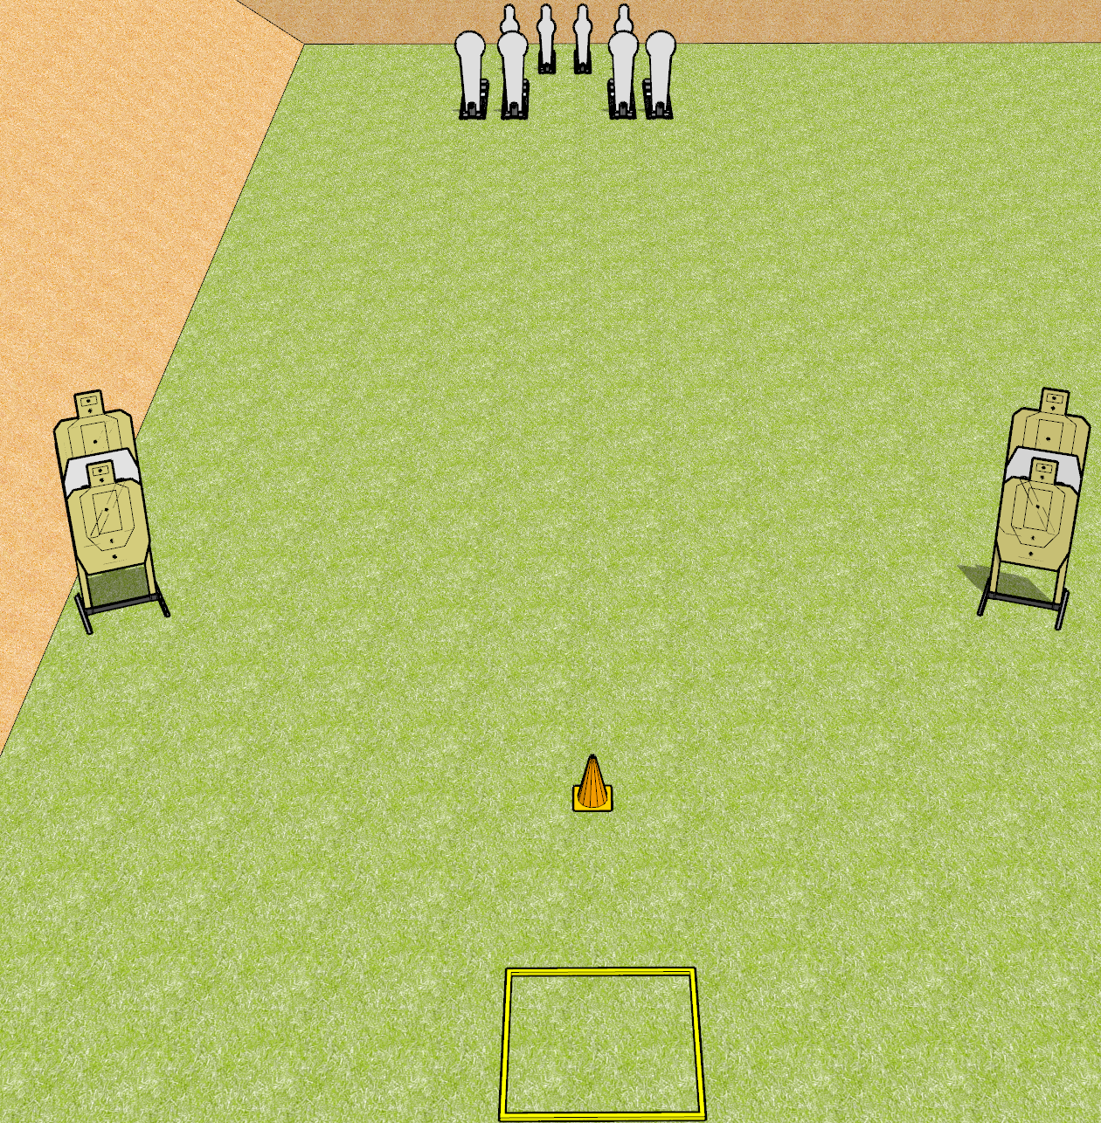
 | Dothan Gun Club – USPSA Match Profoundly Evil Course Designer : Drew Coleman
START POSITION : Standing in shooting box, wrists below belt.
GUN READY CONDITION : Pistol loaded and holstered. PCC loaded, shouldered, safety on, pointed at orange cone. |  | SCORING: Comstock, 16 rounds TARGETS: 4 paper, 8 Steel SCORED HITS: Best 2 on paper, steel until down START-STOP: Audible, last shot RULES: failing to perform a mandatory reload between arrays will be a procedural penalty per shot fired. Failure to fire weak hand/side only will be a procedural per shot fired.
STAGE PROCEDURE: Engage the steel OR the paper, perform a mandatory reload, then engage the remaining array. All paper targets are a single array, all steel is a single array.

Slide 2
Profoundly Evil
Written Stage Briefing
Profoundly Evil is a 16 round, 80 point, Comstock Speed Shoot. There are four USPSA targets, four colt poppers, and four mini poppers. The best two hits on paper will score, and steel must fall to score. The start signal is audible.
Handgun start position is standing in shooting box with wrists below belt. Handgun is loaded and holstered.
PCC start position is standing in shooting box. Loaded carbine is held with both hands, shouldered, safety on, muzzle pointed at orange cone.
Upon start signal, engage either the steel or the paper targets, perform a mandatory reload, then engage the remaining targets weak hand only. PCC weak side only.
Failure to perform a mandatory reload between arrays will be a procedural penalty per shot fired. Failure to fire weak hand/side only will be a procedural per shot fired.

